Slide 1
K-Nearest Neighbors
Mohammed Imaduddin
March 20, 2023
Trainee Data Scientist

Slide 2
AGENDA
INTRODUCTION
INTUITION
EXAMPLES
APPLICATIONS
PROS AND CONS
CONCLUSION
REFERENCES

Slide 3
Introduction
K-Nearest Neighbors -
The K-nearest neighbors algorithm, also known as KNN, is a non-parametric, supervised learning classifier, which uses proximity to make classifications or predictions about the grouping of an individual data point.

Slide 4
K-Nearest Neighbors Algorithm
A powerful classification algorithm used in pattern recognition.
The K-Nearest Neighbors (KNN) is a non-parametric supervised machine learning algorithm. It’s distance-based: it classifies objects based on their proximate neighbor classes.
KNN is most often used for classification, but can be applied to regression problems as well.
It is also called Instance Based Learning or Lazy learner.

Slide 5
What is K ?
K is the number of nearest neighbors.
‘K' in KNN is a parameter that refers to the number of nearest neighbors to include in the majority of the voting process.
Method 1 : K = Sqrt (rows)
Example : We have 64 rows
√64 = 8
We must prefer taking K as odd number to avoid ambiguity.
How to find K ?
Method 2 : Trial and Error
Every value of K
From 1 to K(n-1)
Calculate the accuracy of all and select the best one.

Slide 6
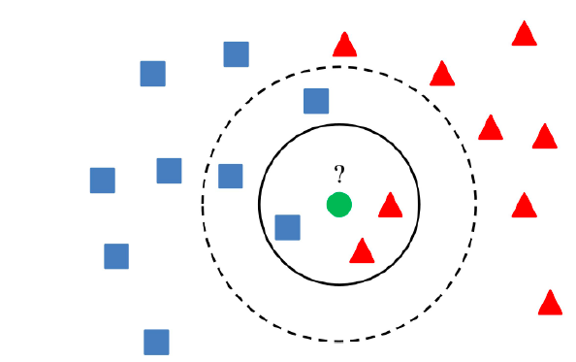
KNN : Classification Approach
An Object (a new instance) is classified by a majority of votes by its neighbor classes.
The object is assigned to the most common class amongst its K nearest neighbors using distance function.

Slide 7
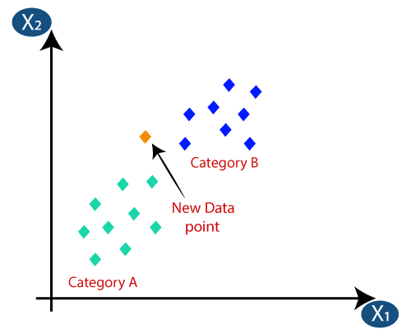
Deciding the Category

Slide 8
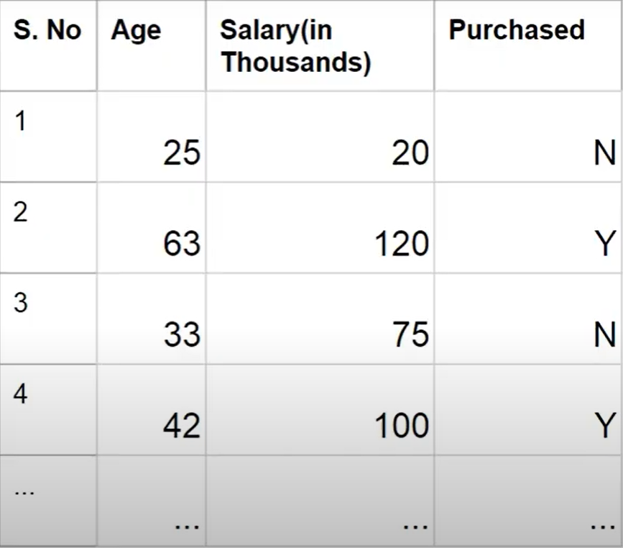
Example Dataset :

Slide 9
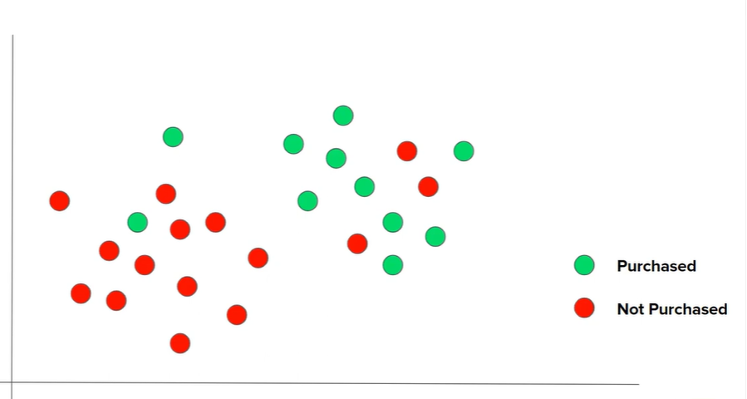
Case 1 : K = 1
Case 2 : K = 3
Case 3 : K = 5
SALARY
AGE

Slide 10
Formulae :
K-distance is the distance between data points and a given query point. To calculate it, we have to pick a distance metric.
Some of the most popular metrics are explained below.
Euclidean distance = sqrt( (x₂-x₁)² + (y₂-y₁)² )
Manhattan distance = absolute sum ||xi-yi||
Minkowski distance = ( (x₂-x₁)^{p} + (y₂-y₁)^{p} )^{1/p}

Slide 11
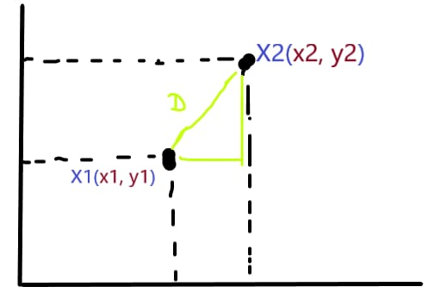
KNN - Euclidean Distance
Let’s take a simple and basic example to illustrate the above mathematical equation.
- Suppose the vector X1 and X2 coordinates are in 2-Dim,
- X1(x₁, y₁) = X1(3, 4)
- X2(x₂, y₂) = X2(4, 7), as you can see in the image.
So these are a 2-Dim vectors so our Euclidean Distance mathematical equation for finding the distance between X1 and X2 is :
Distance = sqrt( (x₂-x₁)² + (y₂-y₁)² )
When we put our coordinates in the equations,
distance = sqrt( (4-3)² + (7-4)² )
distance = sqrt( 1+3² )
distance = sqrt( 10 )
distance = 3.1 (approx)
So, simply we can say that point X2 is 2 distances far
from point X1.

Slide 12
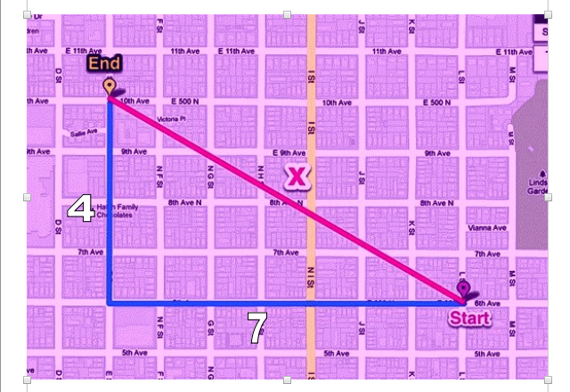
KNN - Manhattan Distance
So, as we know that the Manhattan distance is a little bit the same as the Euclidean Distance, but here we find the absolute value, let’s take an example of it.
Suppose, one cab starting from point X1 and has to reach its destination point X2 so we didn’t calculate its shortest path apart from this we have to calculate its absolute or full path they travel.
As you see in the image the blue line represents the absolute path that the cab travel. As Manhattan formula says :
Distance = absolute sum ||xi-yi||
Distance = (7 + 4)
Distance = 11
So, the absolute path the cab cover is 11.

Slide 13
KNN - Minkowski Distance
More often we say that the Minkowski distance is the generalization or generalized form of the Euclidean and Manhattan distance.
We take both the distance technique and the new technique for finding the distance between vectors. It adds a parameter, called the “P“, that allows different distance measures to be calculated.
So, here we will take the same example as we take in the Euclidean distance measures.
- X1(x₁, y₁) = X1(3, 4)
- X2(x₂, y₂) = X2(4, 7)
Lets take the value of P = 4
Distance = ( (x₂-x₁)⁴ + (y₂-y₁)⁴ )^{1/4}
Distance = ( (4-3)⁴ + (7-4)⁴ )^{1/4}
Distance = ( (1)4 + (3)⁴ )^{1/4}
Distance = ( 1+81 )^{1/4}
Distance = ( 82 )^{1/4}
Distance = approx(2)

Slide 14
Knn Applications
Recommendation Systems
Text Mining
Image Recognition
Finance
Healthcare
Search Engines
Document Retrieval Systems

Slide 15
KNN Advantages
Easy to implement
Adapts easily
Non-Parametric
Interpretable
KNN Disadvantages
Sensitive to outliers, missing values and for imbalanced data.
Curse of dimensionality
Prone to overfitting.
Memory-intensive

Slide 16
Conclusion
K- Nearest Neighbors (KNN) identifies the nearest neighbors given the value of K.
It is a lazy learning and non-parametric algorithm.
KNN works on low dimension dataset while faces problems when dealing with high dimensional data.

Slide 17
Reference Links
https://towardsdatascience.com/k-nearest-neighbors-knn-algorithm-23832490e3f4
https://www.ibm.com/in-en/topics/knn
https://www.analyticsvidhya.com/blog/2021/08/how-knn-uses-distance-measures/

Slide 18
THANK YOU!

